Slide 1
UNIT-V
Probabilistic Reasoning: Representing knowledge in an uncertain domain, the semantics of Bayesian networks, Dempster-Shafer theory,
Planning Overview, components of a planning system, Goal stack planning, Hierarchical planning, other planning techniques.
Expert Systems: Representing and using domain knowledge, expert system shells, and knowledge acquisition.

Slide 2
Reasoning in Artificial intelligence
The reasoning is the mental process of deriving logical conclusion and making predictions from available knowledge, facts, and beliefs.
"Reasoning is a way to infer facts from existing data." It is a general process of thinking rationally, to find valid conclusions.
In artificial intelligence, the reasoning is essential so that the machine can also think rationally as a human brain, and can perform like a human.

Slide 3
Types of Reasoning
Deductive reasoning
Inductive reasoning
Abductive reasoning
Common Sense Reasoning
Monotonic Reasoning
Non-monotonic Reasoning
Note: Inductive and deductive reasoning are the forms of propositional logic.

Slide 4
Representing knowledge in an uncertain domain
Artificial Intelligence (AI) systems often operate in environments where uncertainty is a fundamental aspect.
Representing and reasoning about knowledge in such uncertain domains is crucial for building robust and intelligent systems.
An uncertain domain in AI refers to a field or environment where the information available is incomplete, ambiguous, noisy, or inherently unpredictable.

Slide 5
Characteristics of Uncertain Domains
Incomplete Information: The system does not have access to all the data required to make a fully informed decision.
Ambiguity: Information might be unclear or open to multiple interpretations.
Noise: Data might be corrupted or imprecise due to measurement errors or external factors.
Stochastic Processes: The environment might involve random processes or events.

Slide 6
Representing knowledge in an uncertain domain
Following are some leading causes of uncertainty to occur in the real world.
Information occurred from unreliable sources.
Experimental Errors
Equipment fault
Temperature variation
Climate change.

Slide 7
Probabilistic reasoning:
Probabilistic reasoning is a way of knowledge representation where we apply the concept of probability to indicate the uncertainty in knowledge.
In probabilistic reasoning, we combine probability theory with logic to handle the uncertainty.
Bayesian Statistics

Slide 8
Probability
Probability can be defined as a chance that an uncertain event will occur.
It is the numerical measure of the likelihood that an event will occur.
The value of probability always remains between 0 and 1 that represent ideal uncertainties.
1. 0 ≤ P(A) ≤ 1, where P(A) is the probability of an event A.
2. P(A) = 0, indicates total uncertainty in an event
3. P(A) =1, indicates total certainty in an event A

Slide 9

Probability
We can find the probability of an uncertain event by using the below formula.
P(¬A) = probability of a not happening event.
P(¬A) + P(A) = 1.
Sample space: The collection of all possible events is called sample space.
Random variables: Random variables are used to represent the events and objects in the real world.
Prior probability: The prior probability of an event is probability computed before observing new information.

Slide 10
Probability
Posterior Probability: The probability that is calculated after all evidence or information has taken into account. It is a combination of prior probability and new information.
Conditional probability:
Conditional probability is a probability of occurring an event when another event has already happened.
Let's suppose, we want to calculate the event A when event B has already occurred, "the probability of A under the conditions of B", it can be written as:

Slide 11
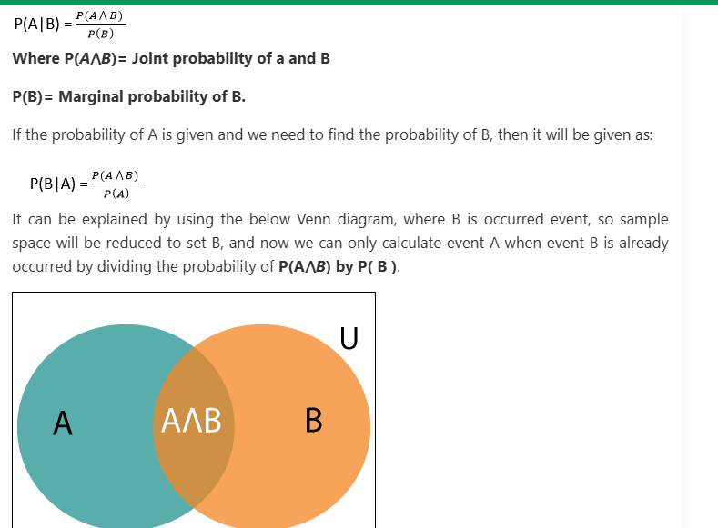

Slide 12

Probability
Example:
In a class, there are 70% of the students who like English and 40% of the students who likes English and mathematics, and then what is the percent of students those who like English also like mathematics?
Solution:
Let, A is an event that a student likes Mathematics
B is an event that a student likes English.
Hence, 57% are the students who like English also like Mathematics.

Slide 13
Bayesian Network
A Bayesian network is a probabilistic graphical model which represents a set of variables and their conditional dependencies using a directed acyclic graph.
Bayesian networks are probabilistic, because these networks are built from a probability distribution, and also use probability theory for prediction and anomaly detection.
Real world applications are probabilistic in nature, and to represent the relationship between multiple events, we need a Bayesian network.
It can also be used in various tasks including prediction, anomaly detection, diagnostics, automated insight, reasoning, time series prediction, and decision making under uncertainty.

Slide 14
Bayesian Network
Bayesian Network can be used for building models from data and experts opinions, and it consists of two parts:
Directed Acyclic Graph
Table of conditional probabilities.
Graphical Representation: Variables are represented as nodes in a directed acyclic graph (DAG), and their dependencies are shown as edges.
Conditional Probabilities: Each node’s probability depends on its parent nodes, expressed as P(Variable | Parent).
Probabilistic Model: Built from probability distributions, BBNs apply probability theory for tasks like prediction and anomaly detection.

Slide 15
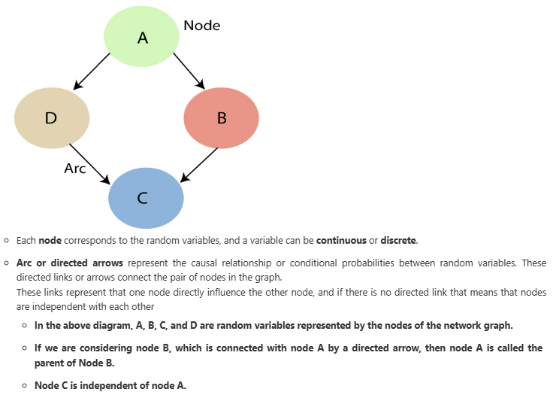
A Bayesian network graph is made up of nodes and Arcs (directed links), where:

Slide 16
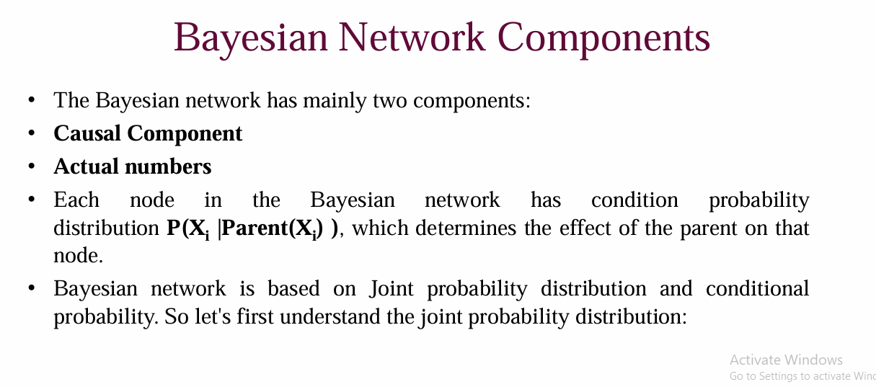

Slide 17
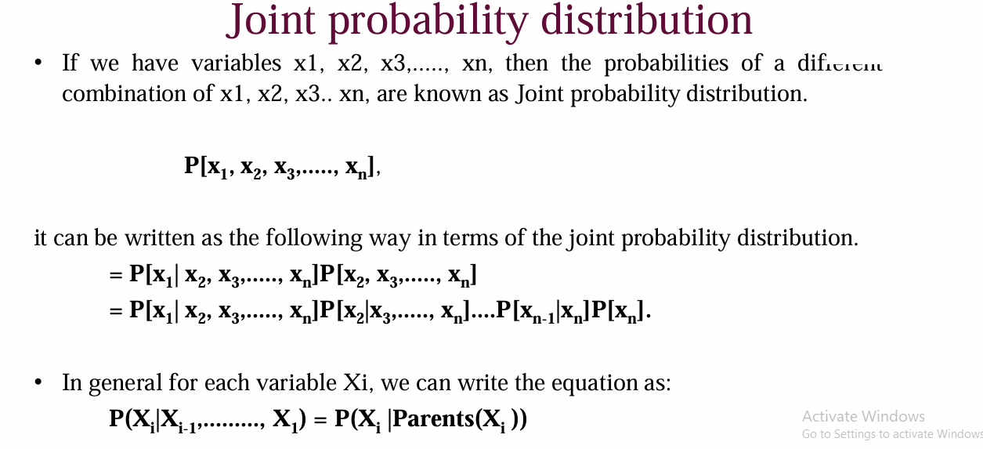

Slide 18
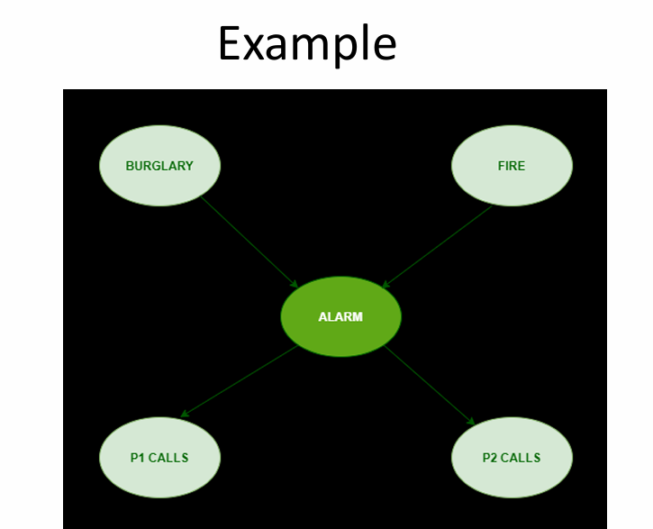

Slide 19
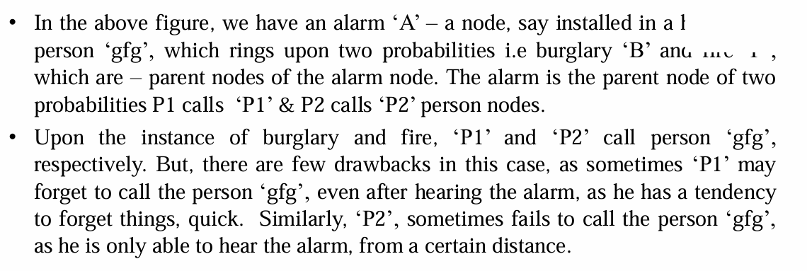

Slide 20
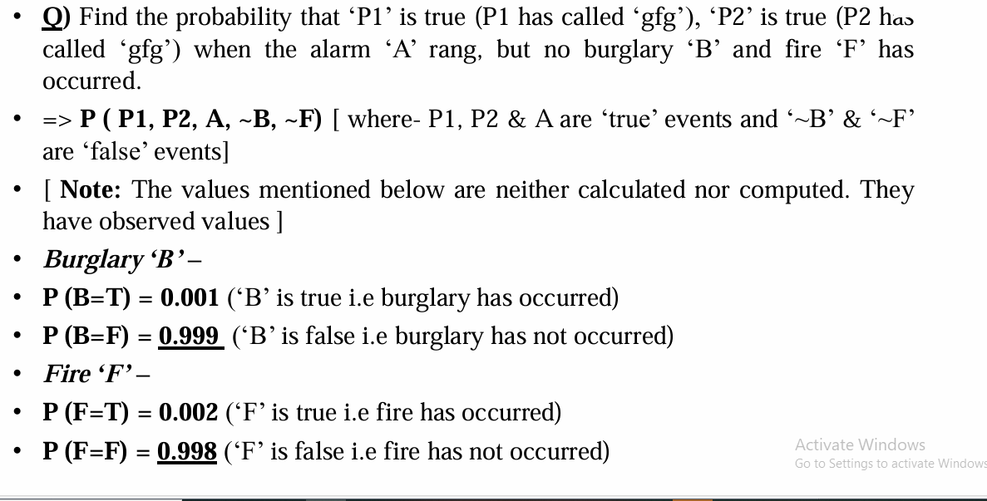

Slide 21
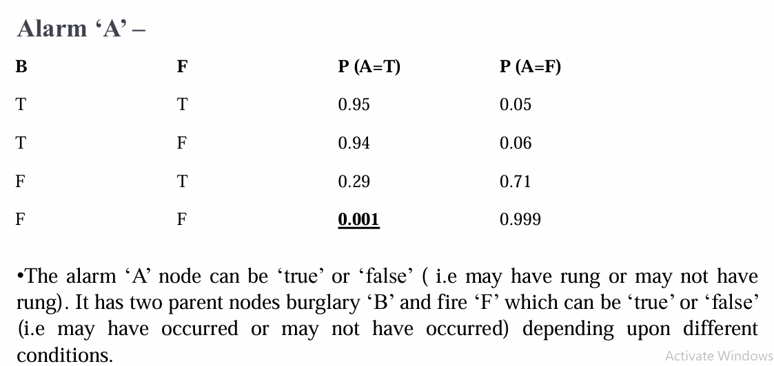

Slide 22
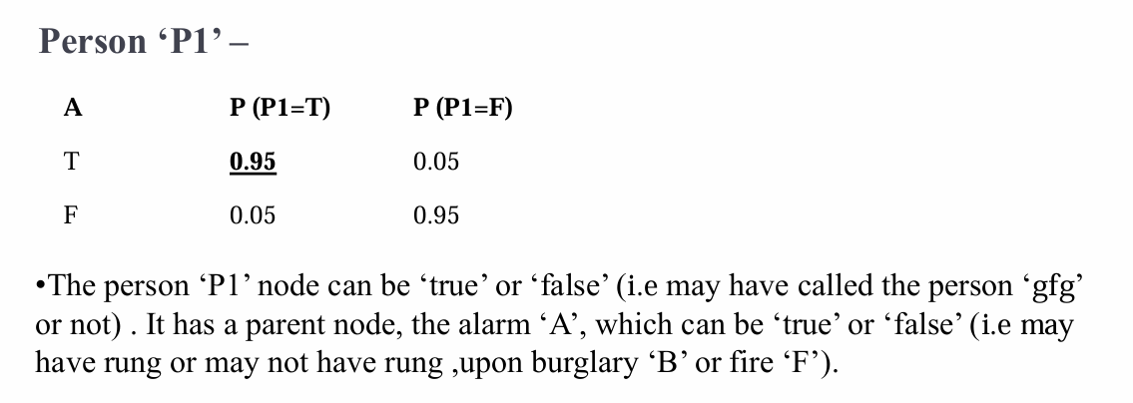

Slide 23
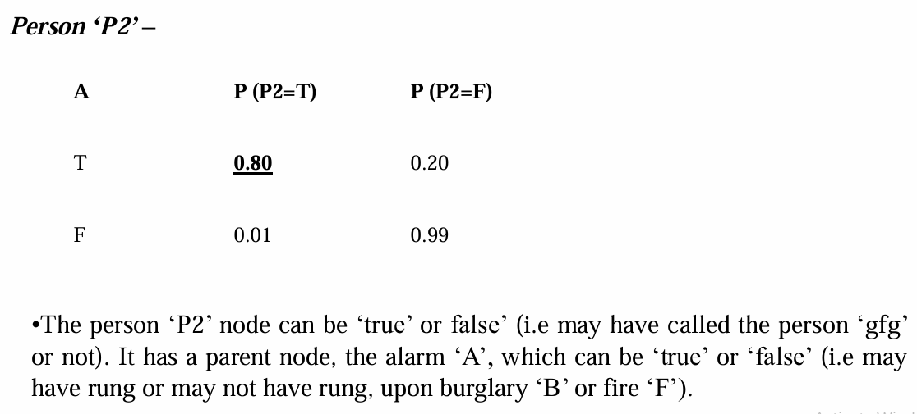

Slide 24
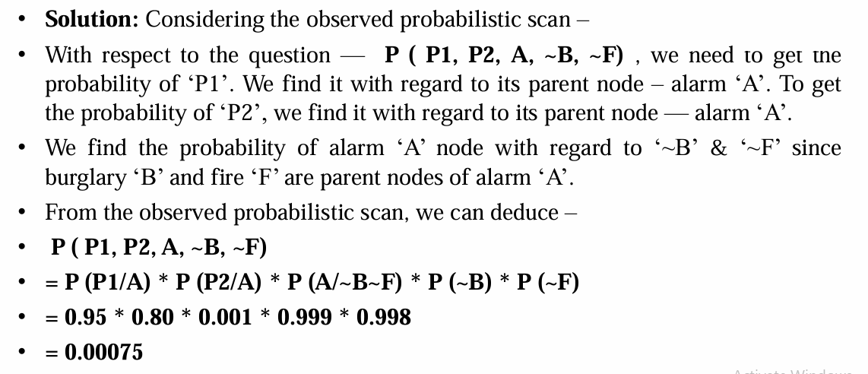

Slide 25
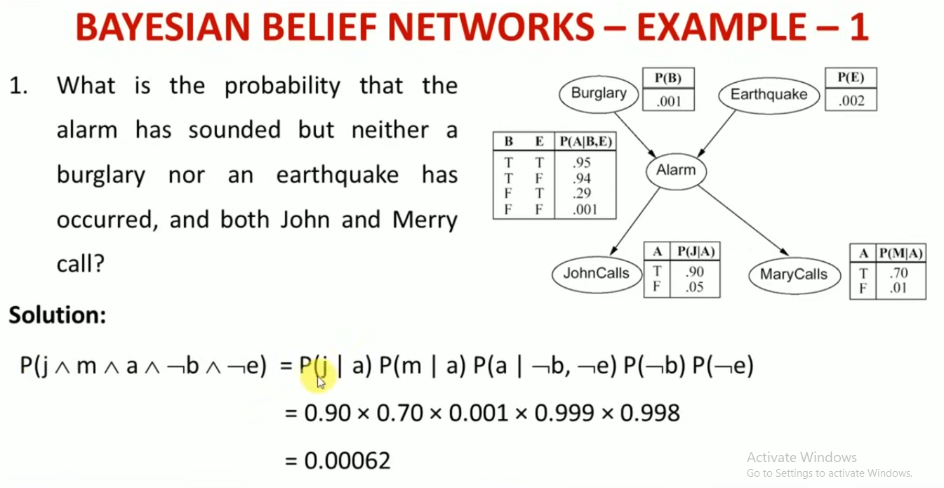

Slide 26
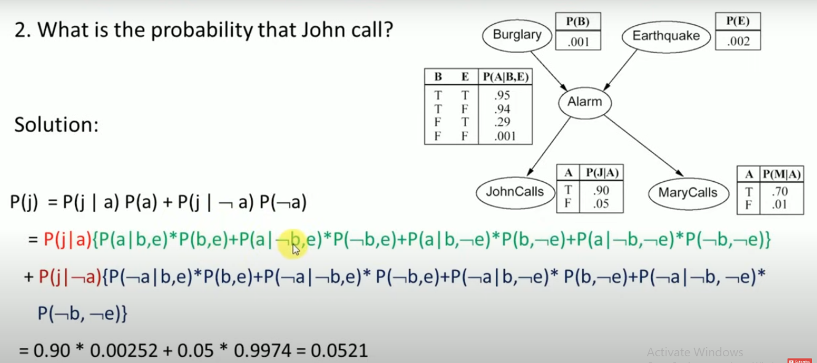

Slide 27
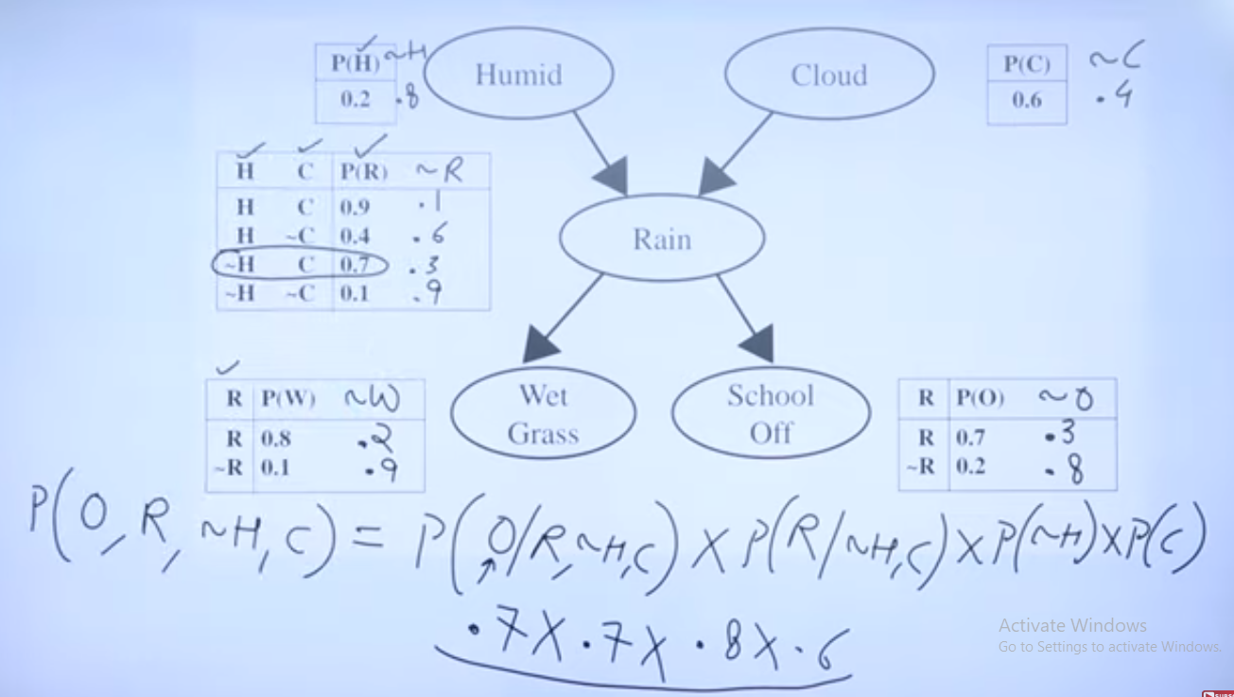

Slide 28
Dempster Shafer Theory
Dempster-Shafer Theory was given by Arthur P. Dempster in 1967 and was later developed by his student Glenn Shafer in 1976. This theory was released because of the following reason:-
Bayesian theory is only concerned about single evidence.
Bayesian probability cannot describe ignorance.
It extends probability theory by allowing us to combine evidence from multiple sources.

Slide 29
Dempster Shafer Theory
How Does the Dempster-Shafer Theory Work?
Unlike regular probability, DST allows for a degree of ignorance.
It helps AI systems combine multiple pieces of evidence, even when some data is uncertain or conflicting.
Instead of assigning precise probabilities, DST uses belief functions to express confidence levels in different possibilities.

Slide 30
Dempster Shafer Theory
The Dempster-Shafer Theory (DST) is a mathematical framework for handling uncertainty and incomplete information in decision-making.
It extends probability theory by allowing for degrees of belief rather than requiring precise probabilities.

Slide 31
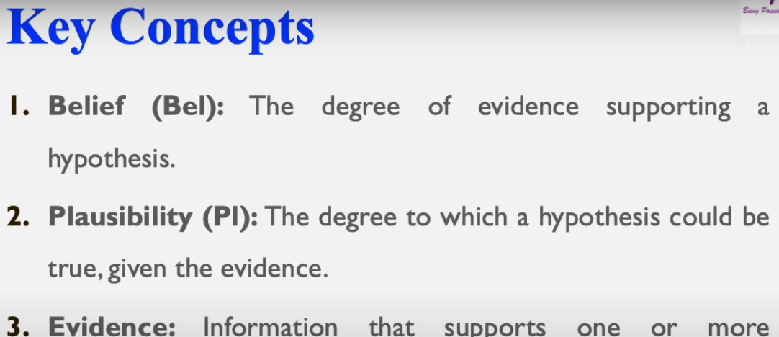

Slide 32
Dempster Shafer Theory
DST is often compared to Bayesian probability, but the two approaches differ in key ways.
Bayesian probability requires precisely defined prior probabilities, whereas DST allows beliefs to be updated dynamically based on new evidence without needing initial probability assumptions.
Dempster’s rule of combination provides a systematic method to merge evidence from multiple sources, making DST particularly valuable in sensor networks, expert systems, and AI-driven diagnostics.

Slide 33
Dempster Shafer Theory
Example:
Let us consider a room where four people are present, A, B, C, and D. Suddenly the lights go out and when the lights come back, B has been stabbed in the back by a knife, leading to his death. No one came into the room and no one left the room. We know that B has not committed suicide. Now we have to find out who the murderer is.
To solve these there are the following possibilities:
Either {A} or {C} or {D} has killed him.
Either {A, C} or {C, D} or {A, D} have killed him.
Or the three of them have killed him i.e.; {A, C, D}
None of them have killed him {o} (let’s say).

Slide 34
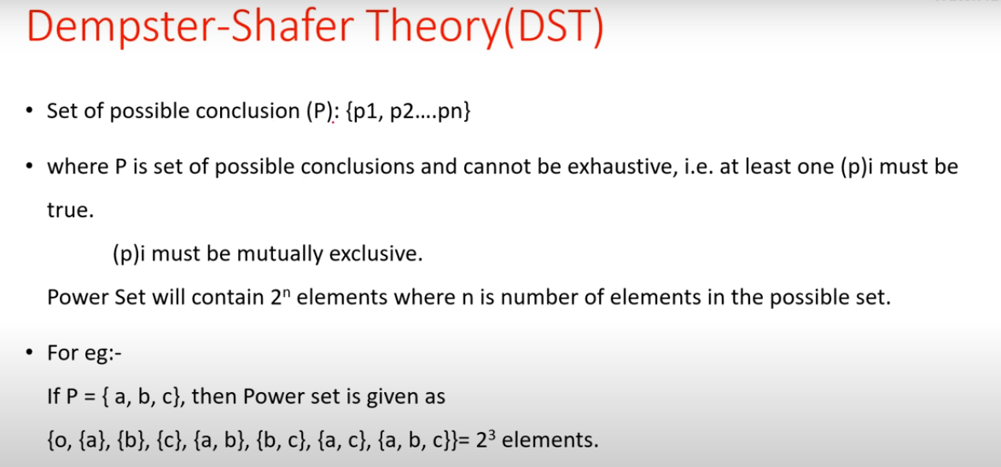

Slide 35
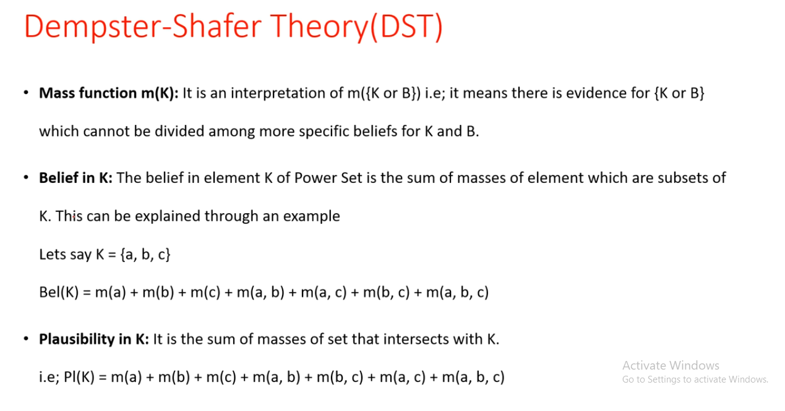

Slide 36
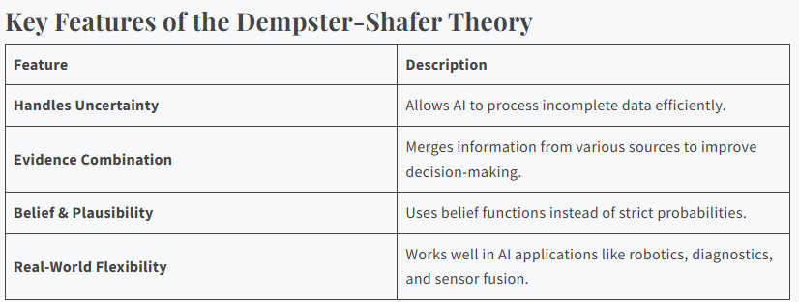

Slide 37
Planning in Artificial Intelligence
In Artificial Intellingence (AI), planning refers to the process of deciding a sequence of actions that a system must take to achieve a specific goal
AI systems use planning algorithms to break down a problem into smaller, manageable tasks and determine the best course of action.
Planning allows machines to:
Think ahead: AI systems evaluate multiple possible outcomes before selecting the optimal one.
Adapt to changes: When faced with uncertain environments, AI systems can revise their plans based on new information.
Act autonomously: Whether it’s an autonomous robot or a smart assistant, AI planning enables machines to perform tasks independently.

Slide 38
Planning in Artificial Intelligence
Example:
In robot navigation, a robot must plan its path from one location to another while avoiding obstacles. The plan would include the robot’s movement decisions, such as turning left, moving forward, and stopping at certain points.
Similarly, in route optimization, AI systems create plans to minimize travel time and cost while ensuring that all
Importance of Planning:
Problem Solving: AI systems rely on planning to break down complex problems into manageable steps, allowing them to find solutions that meet specified goals.
Decision Making: Planning helps AI systems evaluate multiple potential actions and select the best course based on predicted outcomes.

Slide 39
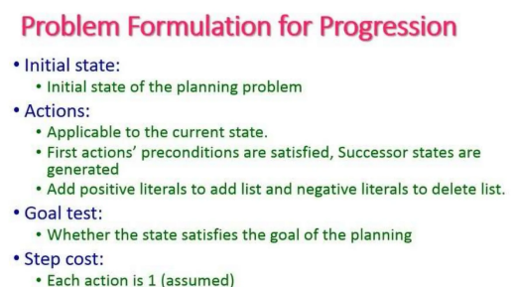

Slide 40
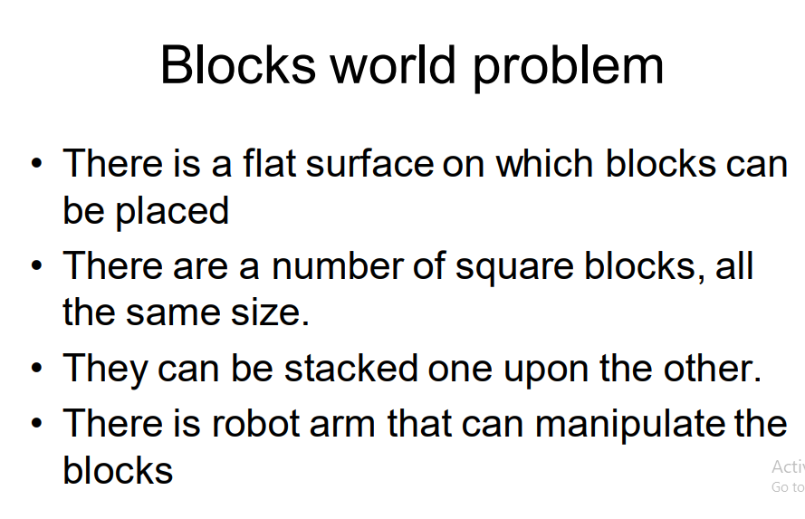

Slide 41
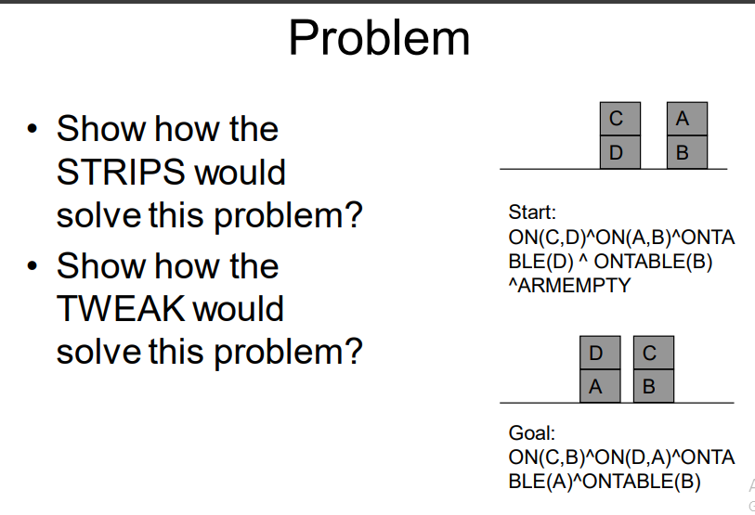

Slide 42
Types of Planning
Planning in AI isn't one-size-fits-all. Depending on the task, AI uses different types of planning in artificial intelligence to solve problems more effectively. So, what are the different types of planning in artificial intelligence, and how do they work? Let's break them down.
1. Classical Planning
Assumes a predictable, static environment where a predefined set of actions leads to goal completion. This works well for simple, well-defined problems using types of planning in artificial intelligence.
2. Hierarchical Planning
Breaks complex problems into smaller sub-problems, creating a hierarchy of plans. This structure enhances efficiency, a key aspect of types of planning in artificial intelligence.
3. Temporal Planning
Focuses on time constraints and dependencies, ensuring actions are sequenced within specific time limits. This is crucial in types of planning in artificial intelligence where timing matters.

Slide 43
Types of Planning
4. Forward State Space Planning (FSSP)
It starts from an initial state and applies actions sequentially to reach the goal state, exploring possible future states along the way with types of planning in artificial intelligence.
5. Backward State Space Planning (BSSP)
Works backward from the goal state, identifying actions to reach the target. This reduces search space complexity in types of planning in artificial intelligence.
6. Goal Stack Planning
It combines FSSP and BSSP using a stack structure to manage goals and actions, ensuring systematic achievement of objectives in different types of planning in artificial intelligence.
7. Non-linear Planning
Allows multiple goals to be pursued simultaneously, optimizing solutions based on various interactions, though it comes with a more complex search space in types of planning in artificial intelligence.

Slide 44
Tools and Techniques for AI Planning
Automated Planners: They are programs that autonomously generate plans, with frameworks like STRIPS and PDDL used for defining planning problems.
Constraint Programming: This powerful technique allows for modeling and solving complex planning issues that involve multiple constraints.
Machine Learning: Reinforcement learning, a subset of machine learning, enhances planning by learning from past experiences and refining strategies based on feedback.

Slide 45
Components of planning
A Simple problem solving tasks basically involve the following tasks:
Choose the best rule based upon heuristics.
Apply this rule to create a new state.
Detect when a solution is found.
Detect dead ends so that they can be avoided.
Detect when a nearly solved state occurs and use special methods to make it a solved state.

Slide 46
Components of planning
1.Choosing Rules to apply :In order to select appropriate rules first isolate a set of difference between the desired goal state and current state and then identify those rules that are relevant to reducing those differences. If several rules are found, a variety of other heuristic information can be exploited to choose among them.

Slide 47
2.Applying Rules
In general case Rules usually specify the problem state, however in our situation rules could also be used to represent a part of the complex problem state. There are many ways to describe such kind of rules.
3. Detecting a Solution :
A planning system will succeed in finding a solution to a problem only when it has found a sequence of operators that transforms the initial problem state into the goal state. But how could a system will know it has found the solution. This could be done by comparing the problem`s goal state with the current state if it matches it we could straightaway say that a solution state has been reached. But on the other hand if the entire states are not represented explicitly but rather described in term of some properties then detecting a solution becomes more complex.This could be solved depending on the way the state descriptions are represented.

Slide 48
Components of planning
. 4.Detecting Dead Ends :
A Planning system might sometime could land into dead-ends when searching for a sequence of operators to solve a particular problem. The same reasoning mechanism that is used for reasoning can also be used for detecting the dead ends.
If the search process is reasoning forward from the initial state, it can prune any paths that leads to a state from which the goal state cannot be reached.
5. Repairing an Almost Correct Solution:
While solving a nearly decomposable problem the sub solutions when combined may not yield a complete solution . So when such situation arises there are certain approaches to handle it. The simplest is just to throw out the solution, look for another one, and hope that is is better. This approach looks simple but it may lead to a great deal of wasted effort.

Slide 49
Goal Stack Planning
Goal stack planning is a technique used in artificial intelligence (AI) to solve complex problems by breaking them down into smaller, more manageable subgoals. It involves organizing goals into a hierarchical structure called a goal stack. Each goal in the stack represents a specific task or objective that the AI agent needs to achieve to solve the overall problem.

Slide 50
Goal Stack Planning
Goal Stack Planning (in short GSP) is the one of the simplest planning algorithm that is designed to handle problems having compound goals. And it utilizes STRIP as a formal language for specifying and manipulating the world with which it is working.
This approach uses a Stack for plan generation. The stack can contain Sub-goal and actions described using predicates. The Sub-goals can be solved one by one in any order.

Slide 51
Goal Stack Planning
Algorithm:
Push the Goal state in to the Stack
Push the individual Predicates of the Goal State into the Stack
Loop till the Stack is empty
Pop an element E from the stack
IF E is a Predicate
IF E is True then
Do Nothing
ELSE
Push the relevant action into the Stack
Push the individual predicates of the Precondition of the action into the Stack
Else IF E is an Action
Apply the action to the current State.
Add the action ‘a’ to the plan

Slide 52
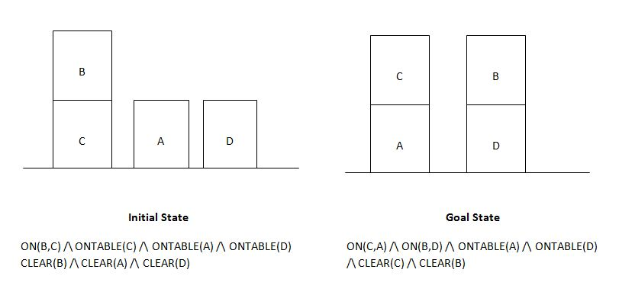
Goal Stack Planning

Slide 53
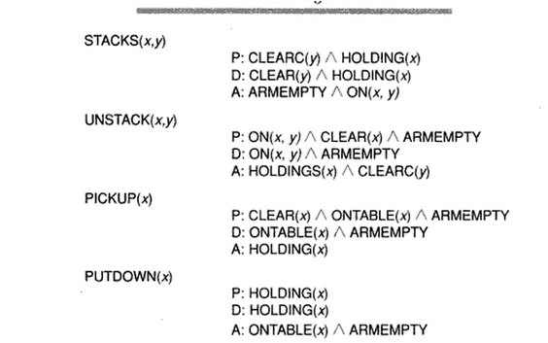
the initial state is our current description of our world. The Goal state is what we have to achieve. The following list of actions can be applied to the various situation in our problem.

Slide 54
Goal Stack Planning (GSP) is a technique used in AI to manage multiple goals by organizing them in a specific order. This method is particularly useful in scenarios where several actions or goals need to be achieved sequentially. In GSP, goals are stacked on top of each other with the most immediate goal placed on top. As each goal is addressed, it is removed from the stack, and the next goal becomes the focus.
The primary advantage of using Goal Stack Planning is its systematic approach to problem-solving. It simplifies complex tasks by breaking them down into smaller, more manageable steps. This method ensures that each goal is addressed in the correct sequence, preventing any oversight or omission that might occur if multiple goals were pursued simultaneously.
To illustrate, consider a robot designed to navigate a room to pick up objects. Using GSP, the robot's tasks might be stacked as follows: navigate to the object, pick up the object, and then navigate back to the start. Each of these tasks would be tackled one at a time, ensuring the robot completes all steps efficiently & without error.
This approach is not only practical but also minimizes errors, as focusing on one goal at a time allows for more concentrated effort & fewer distractions. For students studying AI, understanding & applying Goal Stack Planning can significantly enhance their ability to develop solutions that are both effective & orderly.

Slide 55
Hierarchical Planning in Artificial Intelligence
Hierarchical planning in artificial intelligence (AI) is a planning approach that involves organizing tasks and actions into multiple levels of abstraction or hierarchy, where higher-level tasks are decomposed into a sequence of lower-level tasks. It provides a way to efficiently reason and plan in complex domains by utilizing a hierarchy of goals and subgoals. Hierarchical planning allows AI systems to make decisions at different levels of abstraction, enabling them to tackle complex tasks and environments effectively.

Slide 56
Hierarchical Planning in Artificial Intelligence
In hierarchical planning, the high-level task is represented as the ultimate goal, and it is decomposed into subgoals or actions at lower levels of the hierarchy. The hierarchy can be organized as a tree or a directed acyclic graph (DAG), with the high-level goal as the root node and the lowest-level tasks or actions as leaf nodes. Planning can occur at different levels of the hierarchy, with the system selecting goals and generating plans for achieving subgoals or actions. The plans generated at different levels are then synthesized into a cohesive plan for execution.

Slide 57
Components of Hierarchical Planning
Hierarchical planning in artificial intelligence (AI) typically involves several key components, including:
High-level goals: The overall objectives or tasks that the AI system aims to achieve.
Task decomposition: Breaking down high-level goals into lower-level tasks or subgoals.
Planning hierarchy: The organization of tasks or subgoals into a hierarchical structure, such as a tree or a directed acyclic graph (DAG).
Plan generation at different levels: Reasoning and planning at different levels of the hierarchy, with plans generated for achieving subgoals or actions.
Plan synthesis: Combining the plans for achieving subgoals or actions into a cohesive plan for execution.
Plan execution: Carrying out the actions or subgoals in the plan in the correct order.
Plan adaptation: Revising plans at different levels of abstraction to accommodate changes in the environment or goals.

Slide 58
Types of Planning in Artificial Intelligence
Planning in AI isn't one-size-fits-all. Depending on the task, AI uses different types of planning in artificial intelligence to solve problems more effectively. So, what are the different types of planning in artificial intelligence, and how do they work? Let's break them down.
1. Classical Planning
Assumes a predictable, static environment where a predefined set of actions leads to goal completion. This works well for simple, well-defined problems using types of planning in artificial intelligence.
2. Hierarchical Planning
Breaks complex problems into smaller sub-problems, creating a hierarchy of plans. This structure enhances efficiency, a key aspect of types of planning in artificial intelligence.
3. Temporal Planning
Focuses on time constraints and dependencies, ensuring actions are sequenced within specific time limits. This is crucial in types of planning in artificial intelligence where timing matters.
4. Forward State Space Planning (FSSP)
It starts from an initial state and applies actions sequentially to reach the goal state, exploring possible future states along the way with types of planning in artificial intelligence.
5. Backward State Space Planning (BSSP)
Works backward from the goal state, identifying actions to reach the target. This reduces search space complexity in types of planning in artificial intelligence.
6. Goal Stack Planning
It combines FSSP and BSSP using a stack structure to manage goals and actions, ensuring systematic achievement of objectives in different types of planning in artificial intelligence.
7. Non-linear Planning
Allows multiple goals to be pursued simultaneously, optimizing solutions based on various interactions, though it comes with a more complex search space in types of planning in artificial intelligence.
Since we’ve outlined the types of planning in artificial intelligence, let’s look into the tools and techniques that make these planning methods work efficiently.

